Slide 1

SMART RESUME BUILDER
Transforming your resume into a job magnet using deep learning
Team Members:
Anushka Bhat
Kavya Nandigam
Karthik Balaji
Anjali Polansani
Pauline Korukundo

Slide 2
FUNCTIONAL REQUIREMENTS
Requirement - Must Have | Status
Resume Upload | Upload both PDF and DOCX
Job and Skills Gap Analysis | Done in computing job match
Generate New Resume Aligned skills and experiences, Key sections, Prioritize and reorder based on job description requirements, one-page resume | 3 Key sections - Profile, Experience and Education. Summarisation of original resume into 2 sentence profile. Summarize experience to 2-3 important points Removal of references and other sections that are usually in a CV.
Saving and Exporting New Resume | Save PDF or DOCS
Resume Customization after generation | Editable word document
Provide Feedback on resume quality | Not Done

Slide 3
FUNCTIONAL REQUIREMENTS
Requirement - Nice to Have | Status
Generate New Resume: Multiple Versions | User can regenerate a new resume
Generate New Resume: Compare input resume with generated resume | Display for visual comparison
User Guidance and Support: Tips and explanations on how the system generated the resume and matched my profile to the job description so that I understand the process and can make informed edits | System explains how well user matches the job
User Guidance and Support: Tips and support on using the system | Not Done
Security and Privacy | Not Done

Slide 4
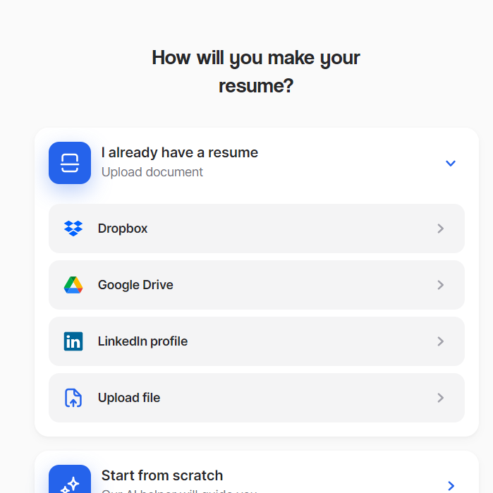
FUNCTIONAL REQUIREMENTS
Requirement - Non-Functional | Status
Performance Resume generation within 20 seconds Support at least 10 concurrent users | Done
Usability: Intuitive user interface so that a user can generate and customize resumes without needing technical knowledge. | Done
Data Quality and Accuracy: As a user, I want the extracted skills and experience data to be accurate so that the generated resume reflects my true qualifications. | 59%
Integration of 3rd Party API Tools such as LinkedIn | Not Done

Slide 5
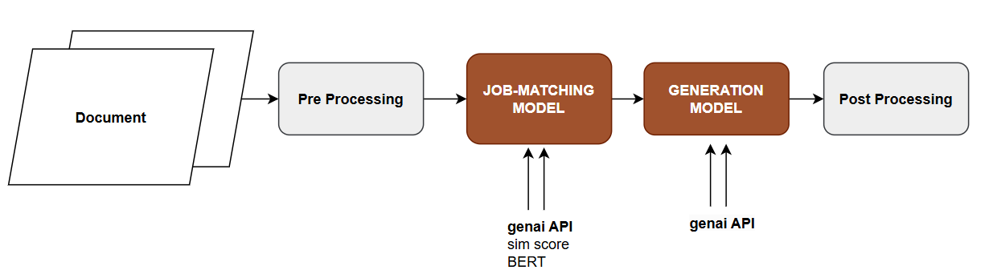
SYSTEM ARCHITECTURE

Slide 6
PERFORMANCE EVALUATION
Resume-Job Fitness
Metric | Transformer | RoBERTa | Gemini Pro | Random Forest | xGBoost
Accuracy | 30.6 | 26.04 | ** | 50.48* | 37.8*
**After training, models provided the same class despite the test data given to it

Slide 7
PERFORMANCE EVALUATION
Generation Models
Metric | Google T5 (%) | Genai (%) | Anthropic
Accuracy | 20 | 59.3
Contextual Relevance | 10 | 57.6
Correctness | 20 | 65.9
Hallucination | 50 | 63.9
t5-v1_1-base

Slide 8
EXPERIENCE
Development of an End-End ML Application
Model Exploration and Analysis for specification applications
Application of Deep Learning tools to real world problems
Using Serverless APIs for fast development
Developing a solution for a User and integration of user feedback
Able to generate a new well formatted resume
Able to summarize a resume for a user, reduce the process of manually summarizing it
Inconsistent Results from LLMs
Insufficient data to warrant training a model for good results
Hardware and platform limitations - disk space and memory - which limited models that could be used

Slide 9
FUTURE SCOPE
Enhancing generation model performance with data of successful resumes
Improvement of scoring model with real world data
Only generating new resumes if Resume-Job match is above threshold to limit model Hallucination

Slide 10

DEMO
http://34.132.65.232:3000/

Slide 11
THANKS
PLEASE KEEP THIS SLIDE FOR ATTRIBUTION

